Slide 1

Minders’ 25 FrontEnd
Workshop
Session Eight

Slide 2


Table of contents
01
02
Recap
DOM

Slide 3
01
Point 1 Recap

Slide 4
Come to the stage
يا حلو (☆▽☆)

Slide 5
02
Point
Dom

Slide 6
What is DOM
DOM = Document Object Model
Represent the webpage in a tree structure
Lets programmers access and manipulate HTML & CSS using JavaScript

Slide 7
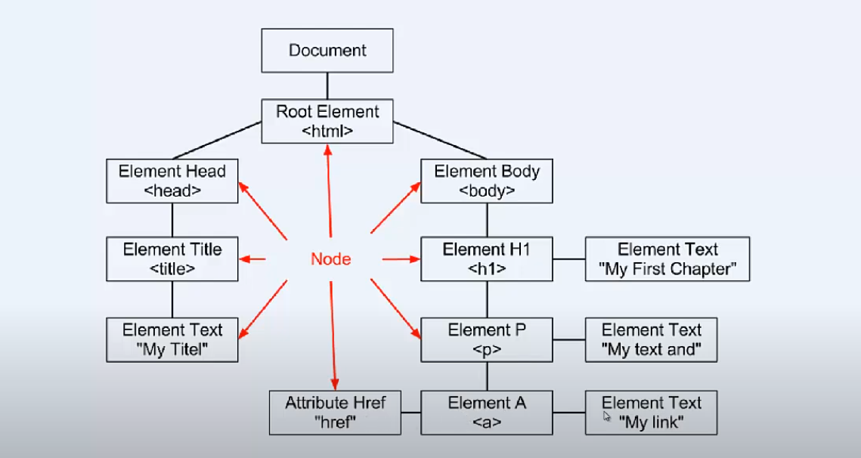
What is DOM
What is the tree structure?

Slide 8
Selecting elements
1-document.getElementById()
2-document.getElementsByTagName()
3-document.getElementsByClassName()
4-document.querySelectorAll()

Slide 9
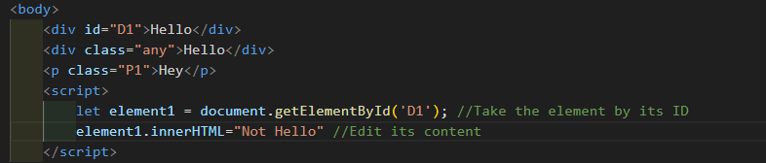
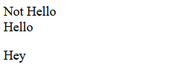
By ID

Slide 10

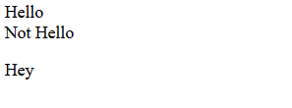
By TagName

Slide 11
By TagName

Slide 12
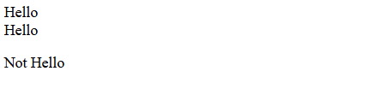
By ClassName

Slide 13
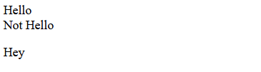
By QuerySelector

Slide 14
Select By Objects
1-document.title
2-document.images
3-document.forms
4-document.body
5-document.anchors
6-document.links

Slide 15

document.title

Slide 16

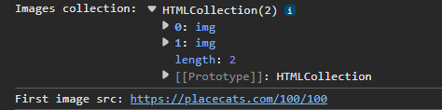
document.images

Slide 17

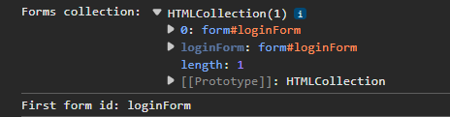
document.forms

Slide 18

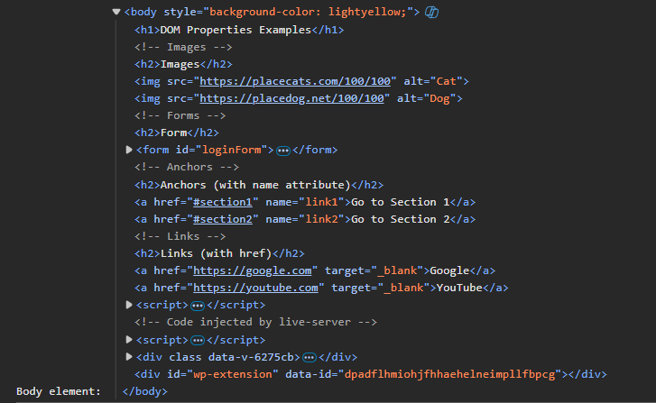
document.body

Slide 19
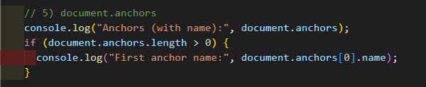
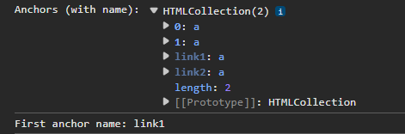
document.anchors

Slide 20
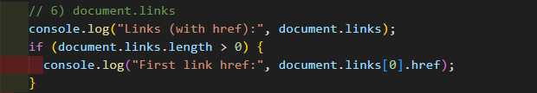

document.links

Slide 21
Element content
element.textContent
element.innerHTML

Slide 22
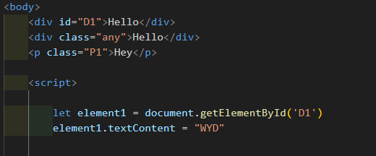
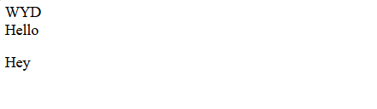
element.textContent

Slide 23

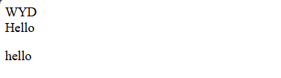
element.innerHTML

Slide 24
Attributes
Element.attribute = “value”
Element.getAttribute(“attribute”)
Element.setAttribute(“attribute”,”value”)
Element.hasAttribute(“attribute”)
Element.removeAttribute(“attribute”)

Slide 25
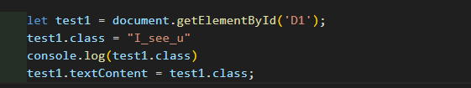
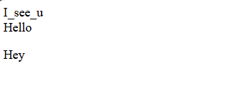

Element.attribute

Slide 26
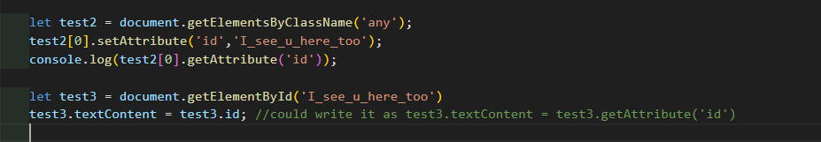
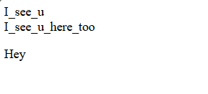

getAttribute/setAttribute

Slide 27
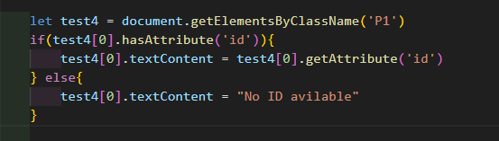
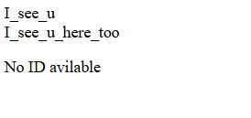
hasAttribute

Slide 28
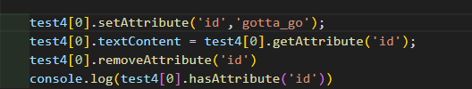
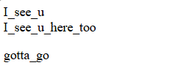
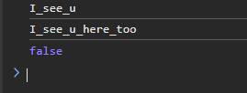
removeAttribute

Slide 29
Children
childNodes
firstChild/firstElementChild
lastChild/lastElementChild
appendChild
InsertBefore
removeChild

Slide 30
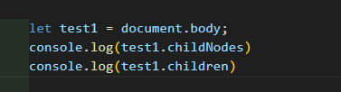
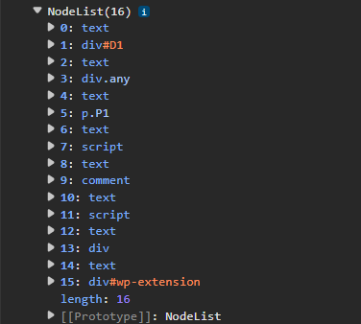
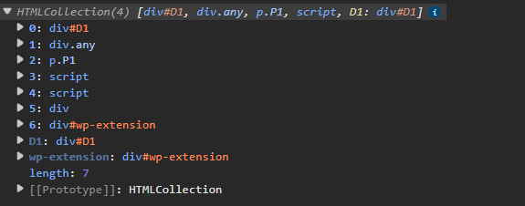
childNodes vs children

Slide 31


firstChild vs firstElementChild

Slide 32

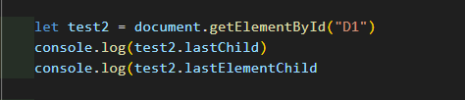

lastChild vs lastElementChild

Slide 33

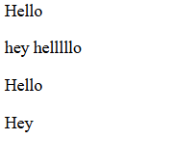
appendChild

Slide 34
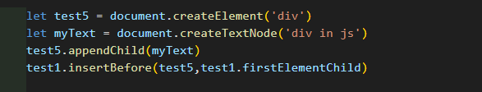
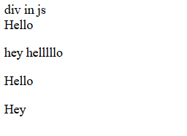
insertBefore

Slide 35

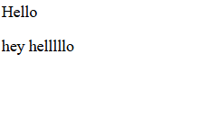
removeChild

Slide 36
Node
nodeName
nodeValue
nodeType
cloneNode
parentNode
Siblings

Slide 37
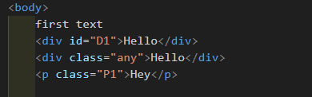


nodeName

Slide 38

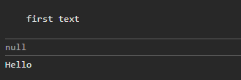
nodeValue

Slide 39


nodeType

Slide 40
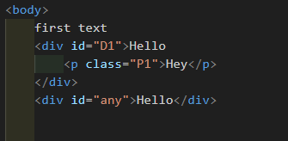
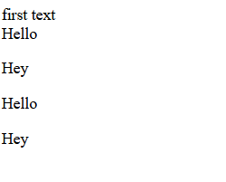
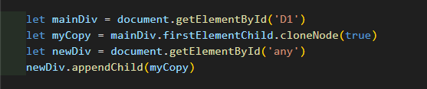
cloneNode

Slide 41
cloneNode

Slide 42
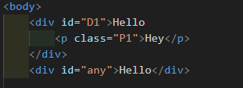

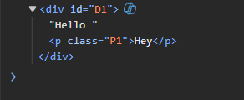
ParentNode

Slide 43


Siblings

Slide 44
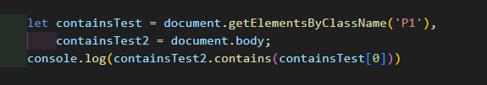

Contains

Slide 45
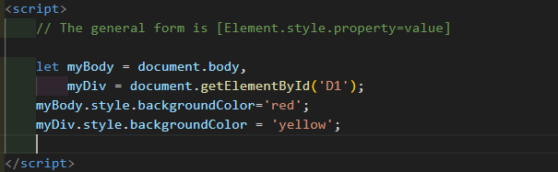
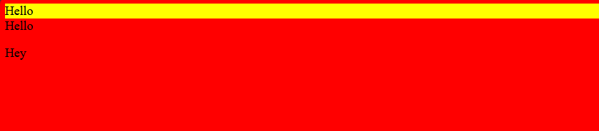
Style

Slide 46
Document
inputEncoding
lastModfied
URL
createElement
createTextNode
createComment
createAttribute

Slide 47
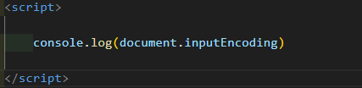
inputEncoding

Slide 48


inputlastModified

Slide 49


URL

Slide 50
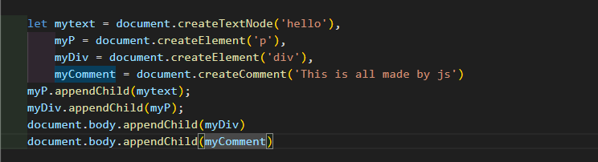
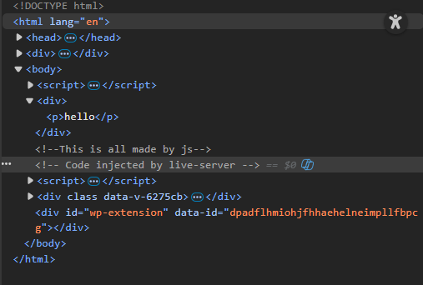
Create

Slide 51

Task One

Slide 52
Make a website with two buttons and paragraph
First button will change the color and text of the paragraph into something else
Second button will reset it to what it was

Slide 53
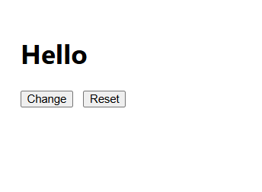
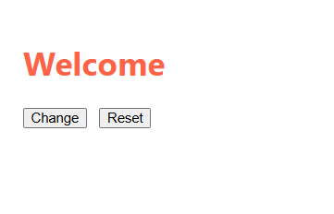

Slide 54
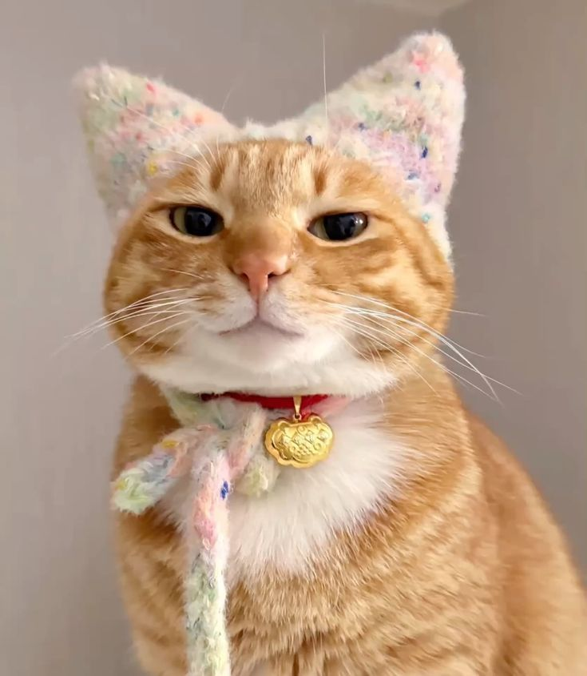
Task Two

Slide 55
Make a website with two buttons and a photo
First button will change the photo into another photo
Second button will reset it to what it was

Slide 56
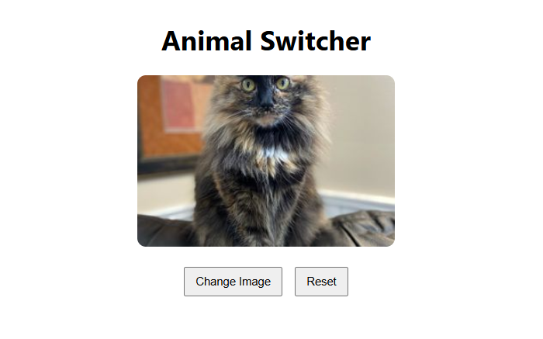
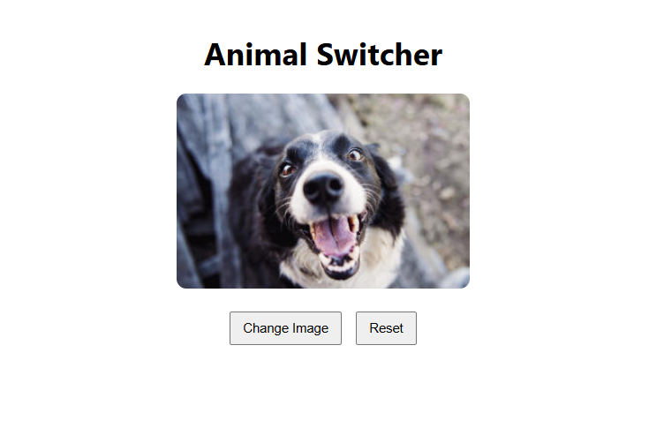

Slide 57
Conclusion

Slide 58
Thanks for Your attention with us (☆▽☆)
Have Good weekends with the tasks o(≧∀≦)o

